Slide 1
Survey data analysis Week 45: “Designing weights”
© Peter Lugtig

Slide 2
Literature today
Exercise last week
Bias-variance trade-off
Adjustment error
Paradata
Short lecture
How to design and select covariates for weights?
Issues in weighting
Brick (2013)
Class discussion
Exercise on calibration, raking

Slide 3
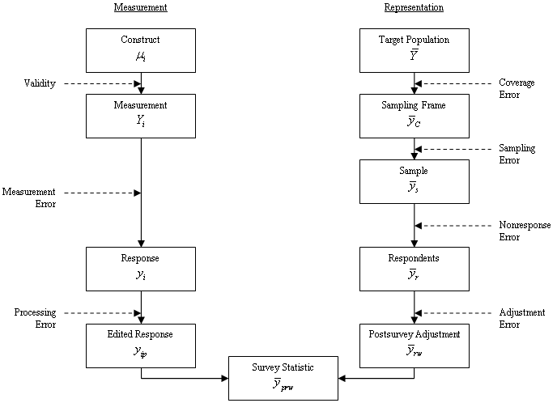
Total Survey Error (TSE) Framework
(Groves et al. 2009, p.48)

Slide 4
Nonresponse bias
Deterministic
It is a function of the nonresponse rate M/N and the difference between the respondents’ r and the nonrespondents’ m population values.
Probabilistic
It is a function of the correlation σ of the survey outcome y with the response propensity ρ and the mean response propensity measured in the target population (Bethlehem 2002).
Note that nonresponse bias is always estimate-specific!

Slide 5
Exercise nonresponse weights
Discussion
Is weighting succesful?
What happens to bias?
MAR or MNAR?
What happens to standard errors

Slide 6
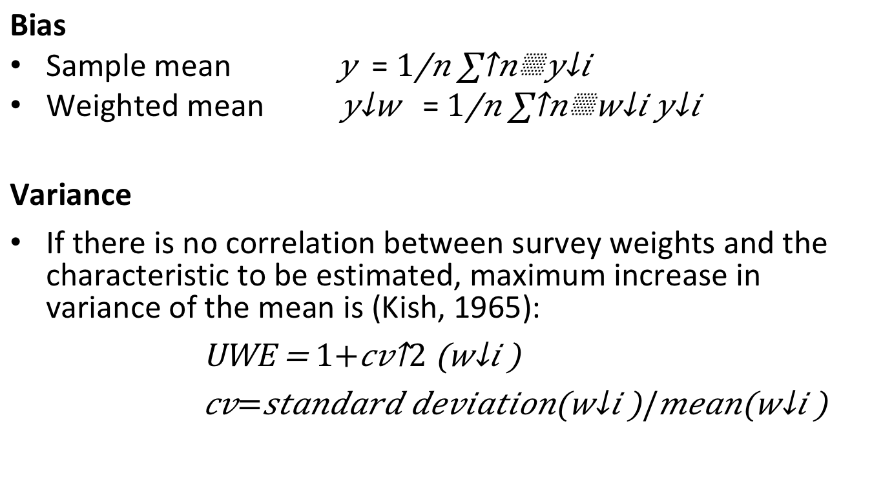
Bias-variance trade-off
Bias
Sample mean $\overline{ y}$ = $\frac{1}{n}\sum^{n}{y_{i}}$
Weighted mean $\overline{ y_{w}}$ = $\frac{1}{n}\sum^{n}{w_{i}y_{i}}$
Variance
If there is no correlation between survey weights and the characteristic to be estimated, maximum increase in variance of the mean is (Kish, 1965):
UWE = $1+{cv}^{2}\left(w_{i}\right)$
$cv=standard deviation\left(w_{i}\right)/mean\left(w_{i}\right)$

Slide 7
Succesful NR weighting
When (NR) weighting is succesful
Little and Vartivarian (2005)
 | X -> R weak | X -> R strong
X-> Y weak | Nothing happens | Still bias Variance inflation
X -> Y strong | Bias somewhat reduced | Bias reduced Variance inflation
X
Z
R
Y
MAR

Slide 8
Bias-variance trade-off(2)
To avoid the inflation of variance
Outlier trimming
Trimming weights >3 to 3
Propensity score weighting
Use 5 bands of propensity scores

Slide 9
Designing weights
Sample level information
Location, gender, age, ….
?
Population level information
LOTS of potential variables
Gender, age, education, ethnicity, region, income
Membership of union, newspaper readership, politically active, visited the Efteling, etc,

Slide 10
Designing weights
Sample level information
Location, gender, age, ….
? ---- paradata
Population level information
LOTS of potential variables
Gender, age, education, ethnicity, region, income
Membership of union, newspaper readership, politically active, visited the Efteling, etc,

Slide 11
Paradata
By-product of doing research
Surveys
F2f: Interviewer observations
Or Recordings
CATI: Call record data
WEB: Browser data, Response timings, section timings, evaluation questions, etc.

Slide 12
Paradata – so what?
Interviewer observations
Useful in nonresponse corrections
Strong link X -> Y
X
Z
X
Z
X
Z
R
Y
R
Y
R
Y
MCAR
MAR
MNAR

Slide 13
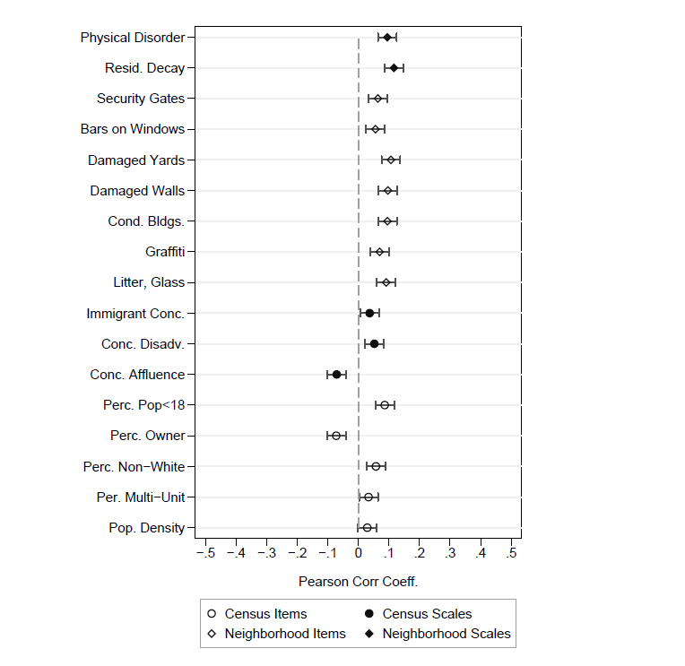
Interviewer observations example Casas-Cordero (2010)
Relations X -> R.
Bivariate (logistic) relations rather weak,
… but strong link with Y?
Figure taken from Casas-Cordero (2010)

Slide 14
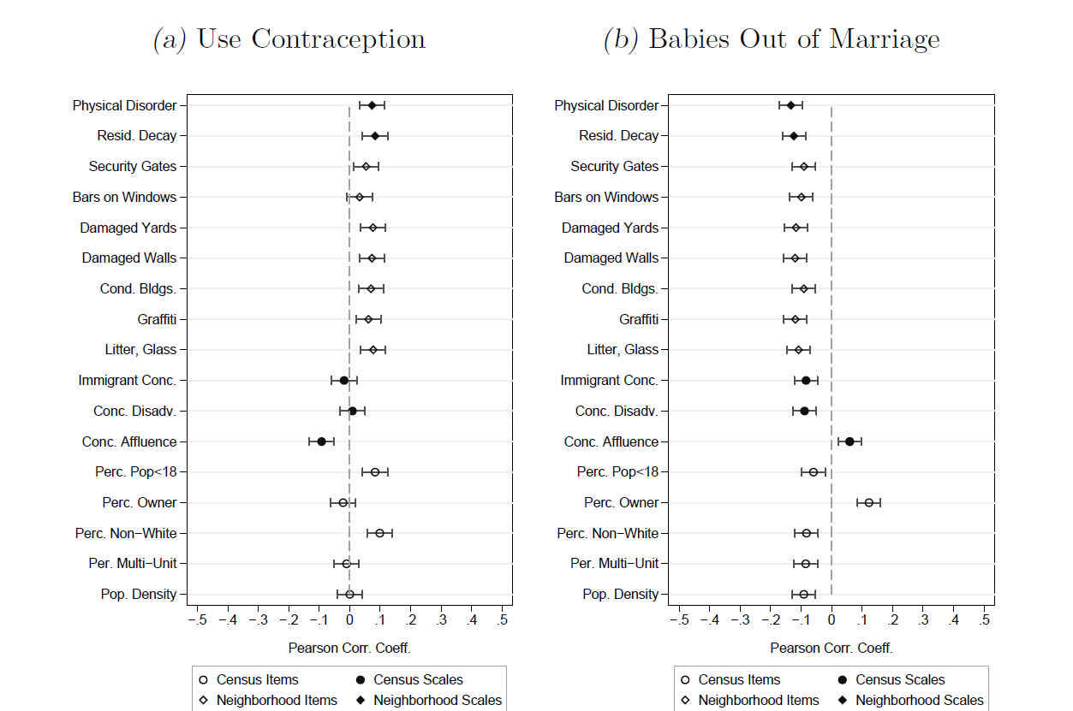
Interviewer observations (2)
Relation X-> Y. Figure taken from Casas-Cordero (2010)

Slide 15
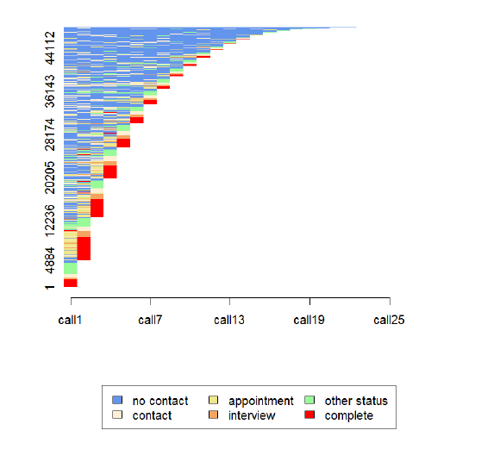
Call record data?
Sequence analysis
Taken from Durrant, Mavlovskaya & Smith, 2014, Sequence analysis as a tool for analysing call record data. NCRM working papers

Slide 16
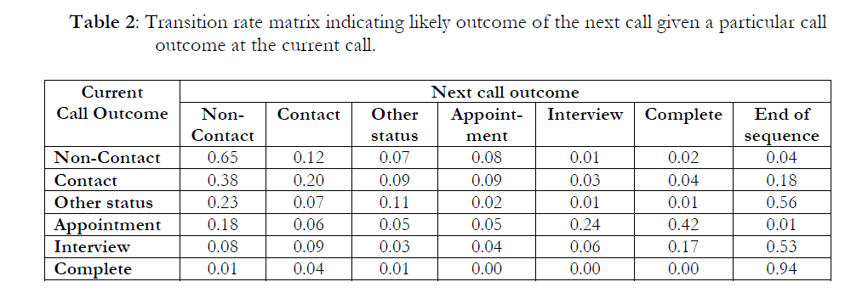
Call record data
Taken from Durrant, Mavlovskaya & Smith, 2014, Sequence analysis as a tool for analysing call record data. NCRM working papers

Slide 17
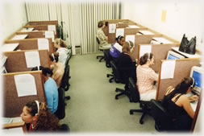
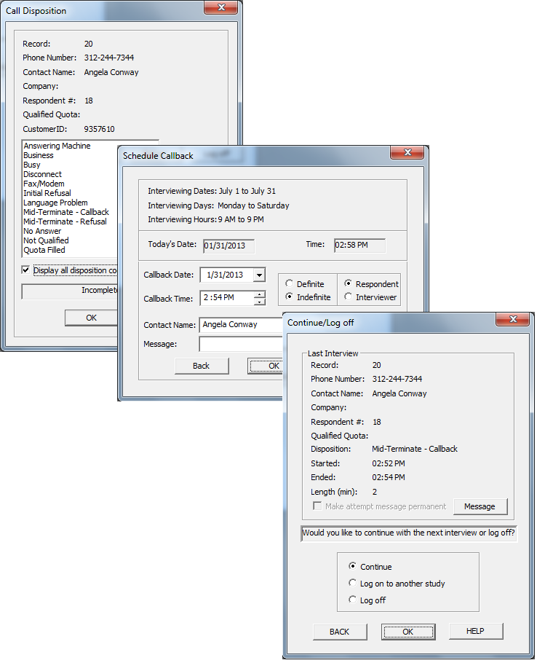
Fieldwork monitoring Telephone
Telephone
Highly centralized
Automatic call schedules ->
If not automated
Vary the time and day of calling
Try to predict best calling times
E.g. if someone works, probably try in evening
Keep to your appointments
Record interviewers if possible
For analysis and quality control purposes

Slide 18
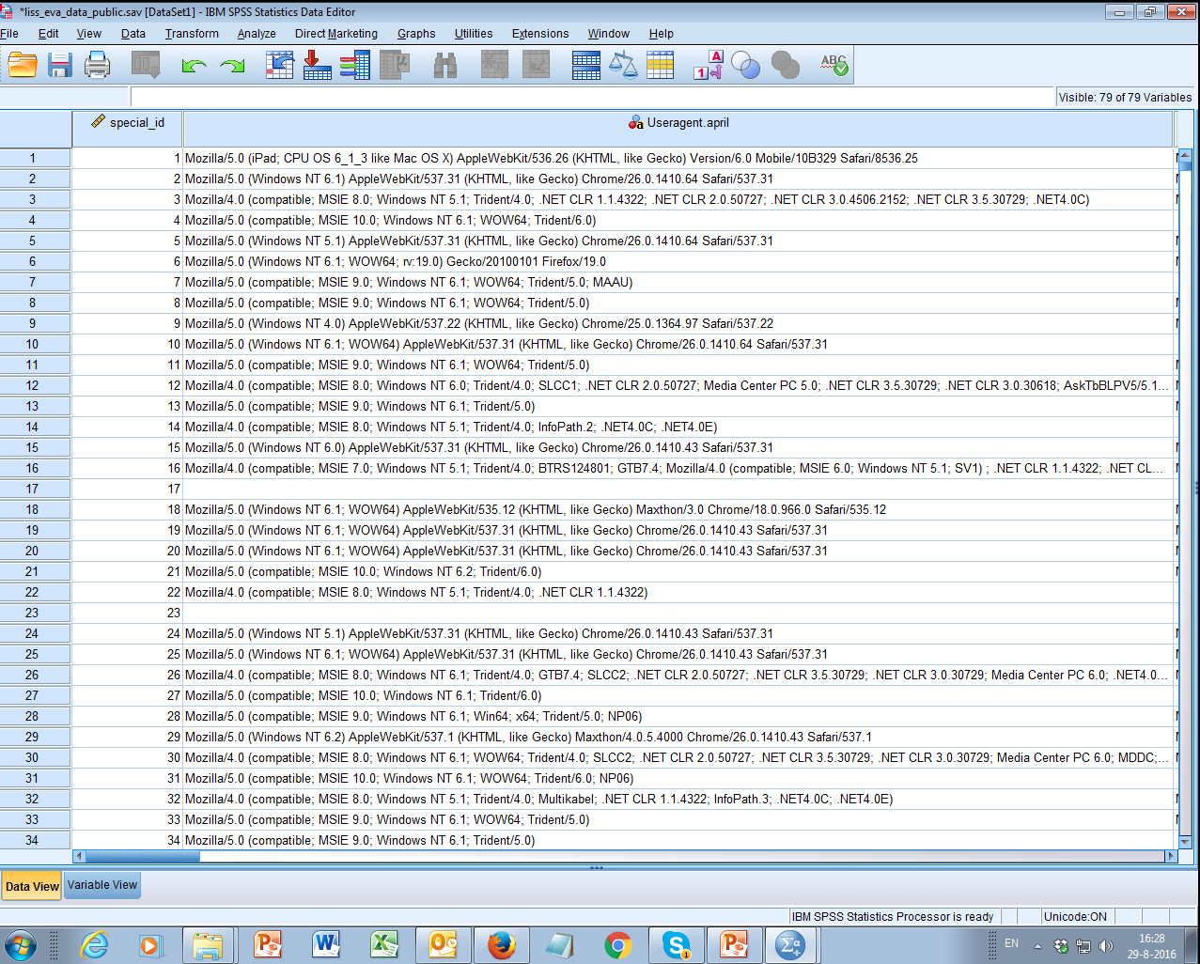
Paradata – web
User Agent strings:

Slide 19
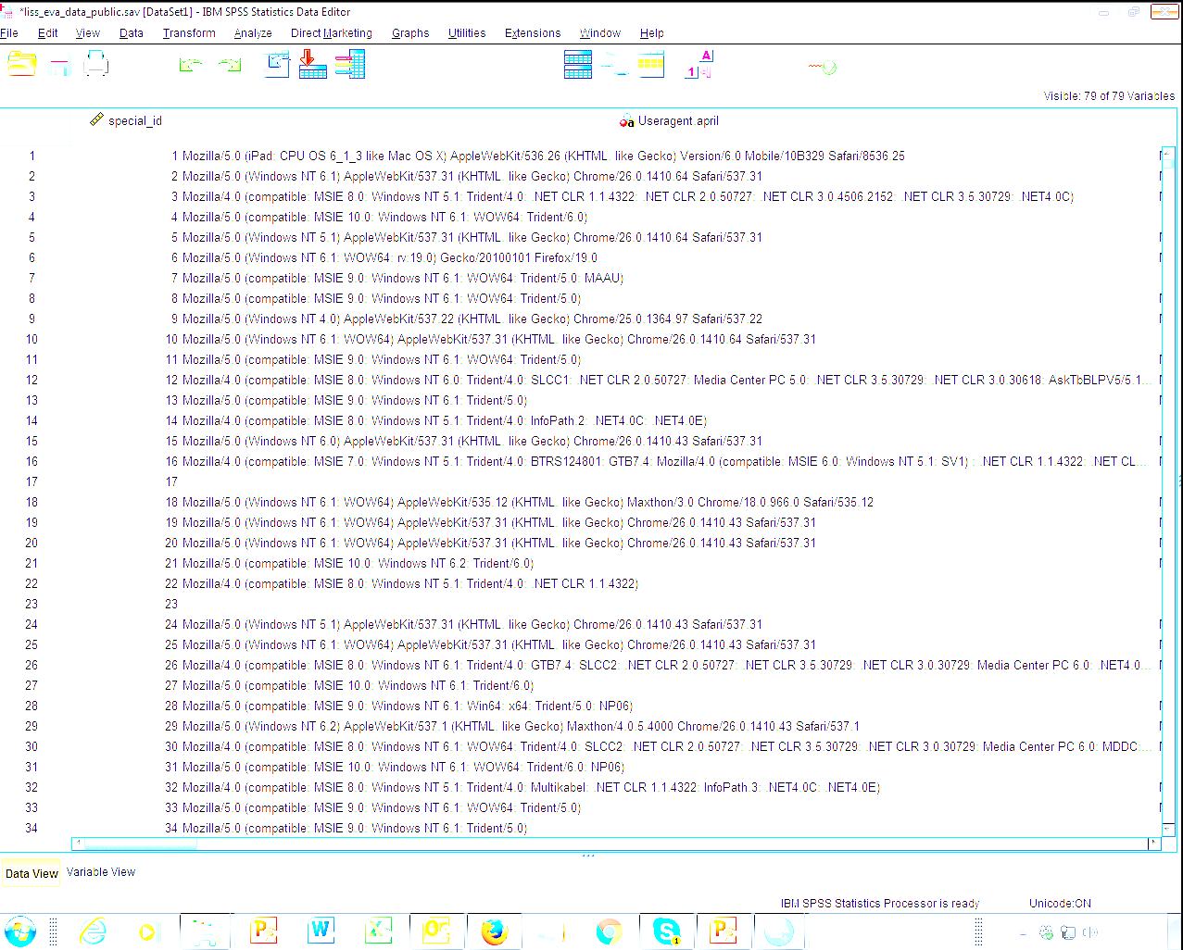
Device type: ipad
Operating system: OS X 6.1.3
Browser: Safari
Version: 6.0

Slide 20
User agent strings Example by Lugtig and Toepoel (2015)
% Device used in month (t) |  | % Device used in May
 |  | PC | Tablet | Phone | No participation |  | N | % of wave respondents
April | PC | 77.4 | 1.1 | 0.4 | 21.1 |  | 4966 | 90.2
 | Tablet | 19.3 | 24.4 | 0.2 | 56.1 |  | 435 | 7.8
 | Phone | 33.9 | 4.6 | 30.3 | 31.2 |  | 109 | 2.0
 | No participation | 37.6 | 2.1 | 0.8 | 59.4 |  | 715 | -

Slide 21
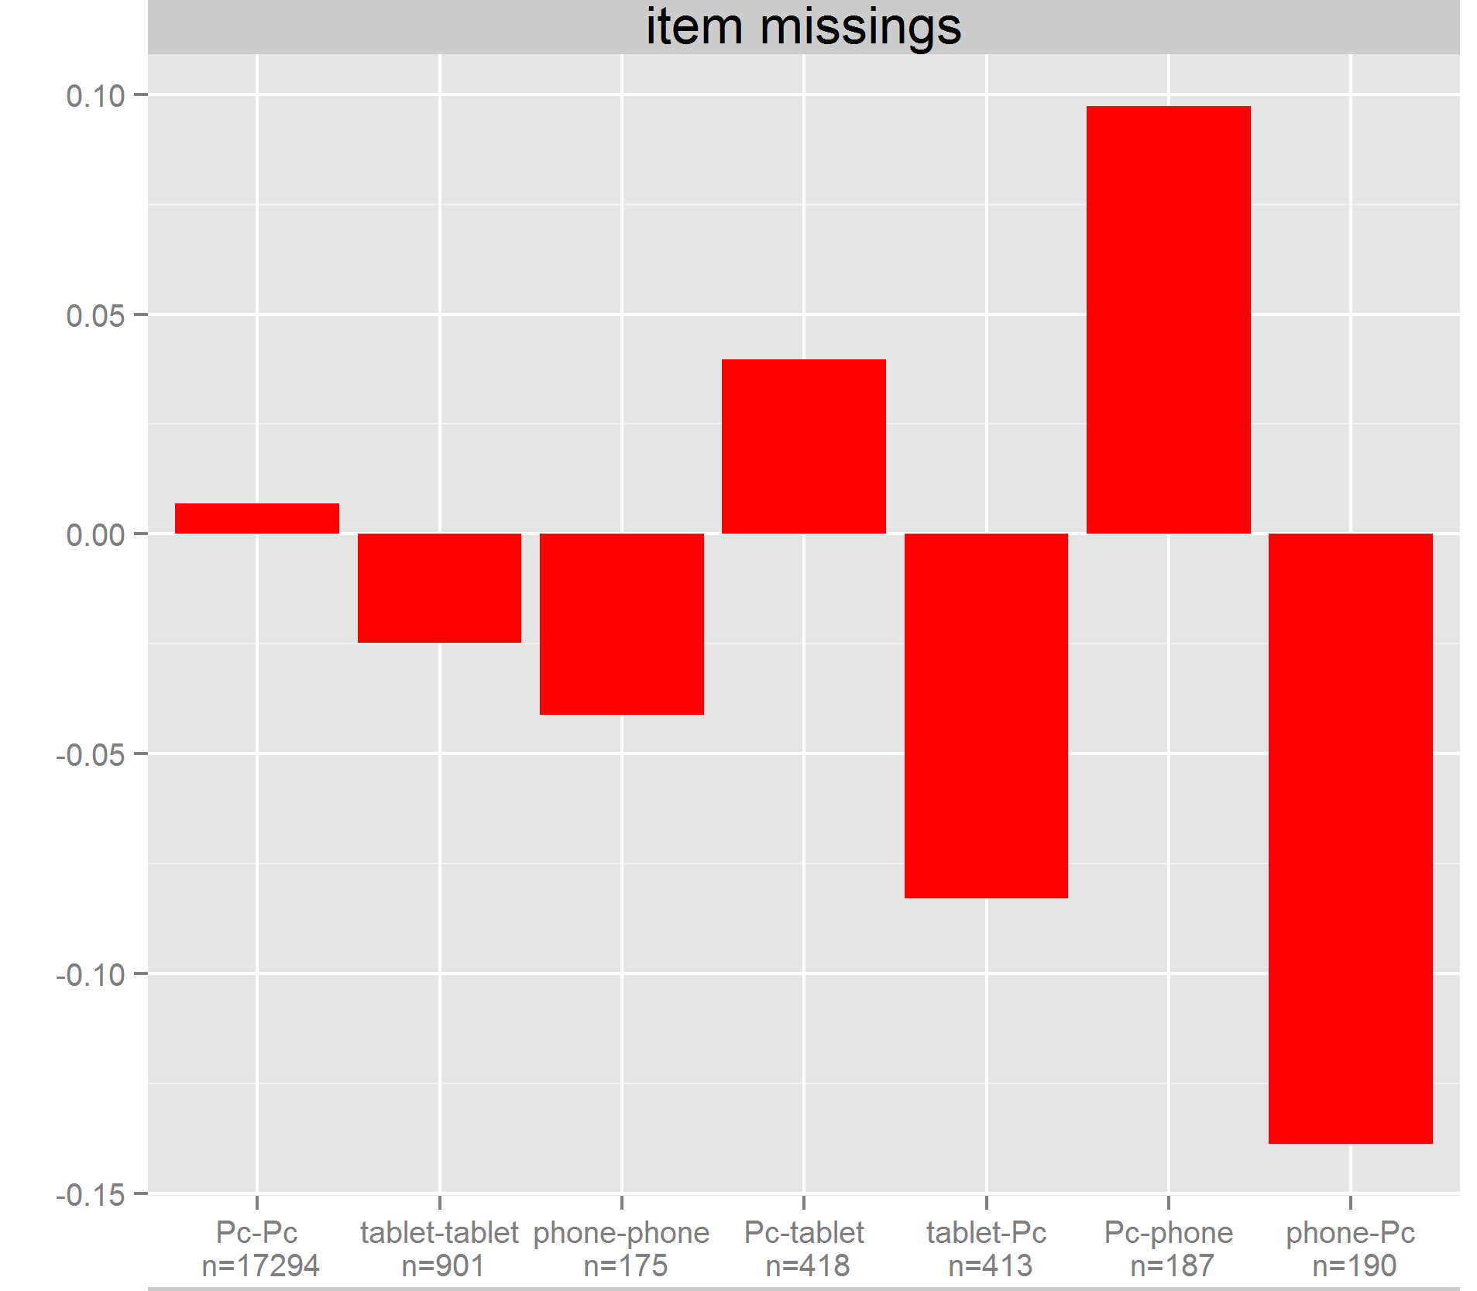
User agent strings Example by Lugtig and Toepoel (2)

Slide 22
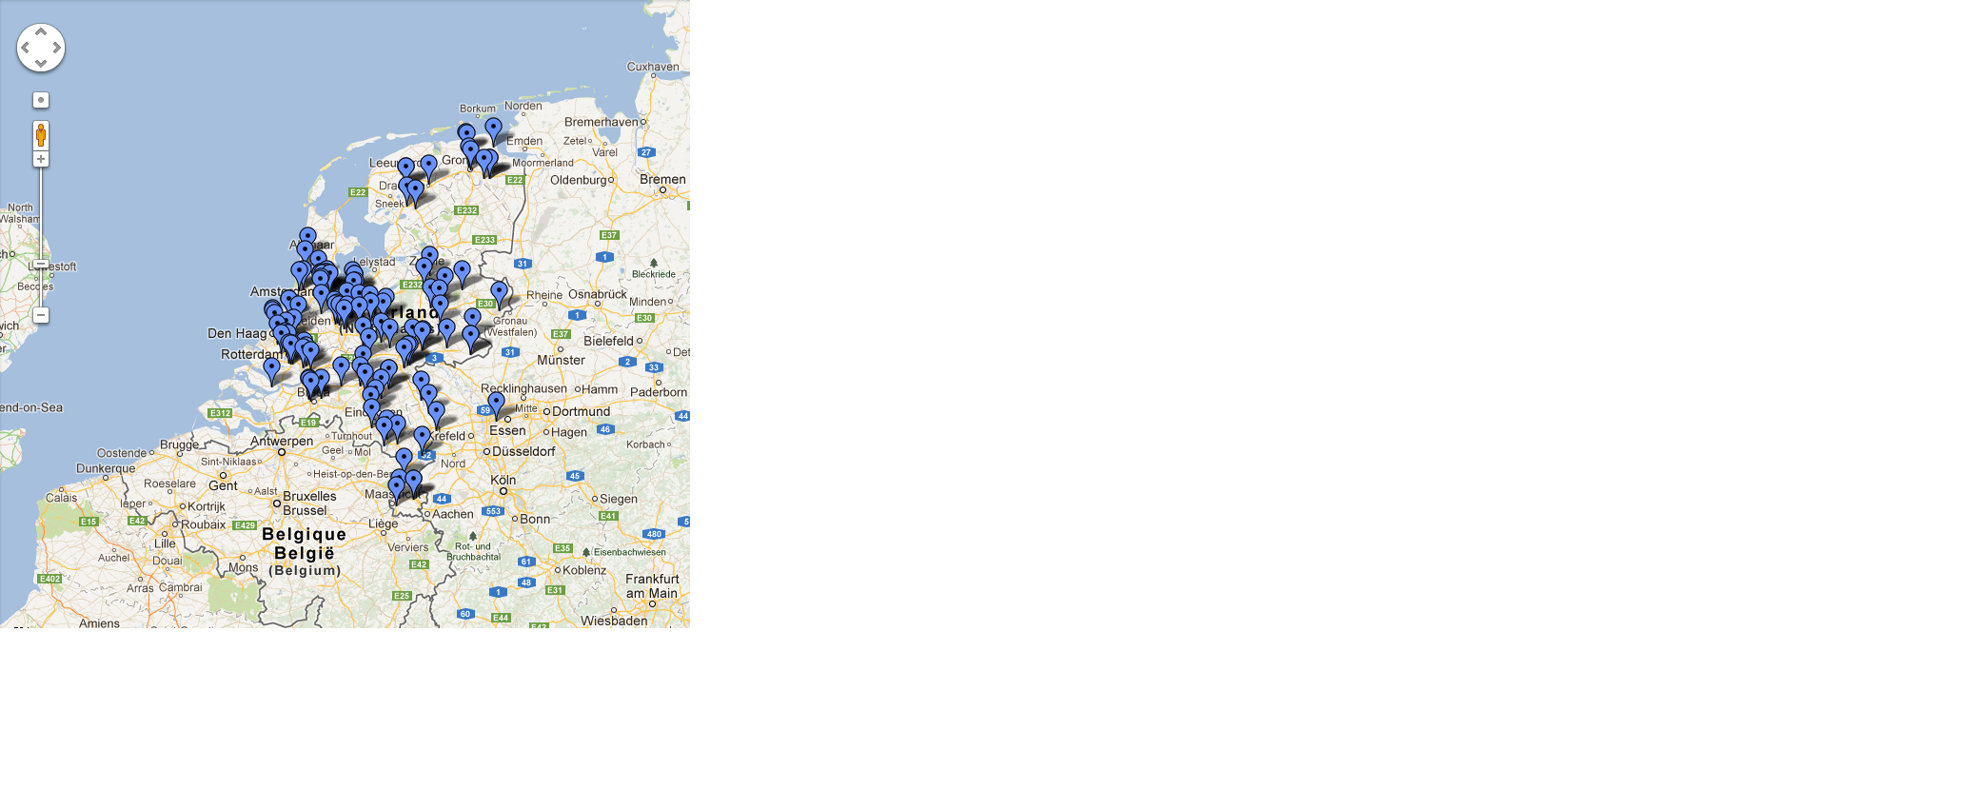
Paradata +++
Taken from Toepoel and Lugtig (2014)
more in week “designed big data”

Slide 23
How to use paradata
Scheduling what to do next -> reduce costs
Call scheduling, interviewer visits
Planning next wave of data collection
Longitudinal, or repeated surveys
For corrections!
Use interviewer observations to weight (or impute)
Use type of nonresponse and make separate models.
Noncontact <- age + #hh members + work
Refusal <- level of education + gender

Slide 24
Brick (2013)
Review of weighting approaches
Propensity score models
Sampling frame data is limited
Population information is limited
Other weighting models
Can we use more information?
Section 7: paradata?

Slide 25
Brick (2013)
Review of weighting approaches
RHG – response homogeneity groups
Groups of propensity score models
Responsive design models
Adjust fieldwork efforts so that P_{respond} = equal
Var (p_{respond}) = 0

Slide 26
Designing weights in R
Design your study such that
You get a rich frame (paradata)
You ask about known population statistics that predict Y
2. Find variables (x) that predict both R and Y
propensity score weighting
Poststratify
calibrate (linear weighting)
Rake

Slide 27
Class exercise
Website of Statistics Netherlands: statline
https://opendata.cbs.nl/statline/#/CBS/en/
Find auxiliary variables for your scenario
Should predict your Y
… and nonresponse
15 minutes in groups of 4

Slide 28
How to use variables in R…
‘survey’ library
Imagine: auxiliary data for sex, age
PostStratify(design= svy.unweighted, strata = agegender, population=agegender.dist
Calibrate(design=svy.unweighted, formula = ~age+gender , population=c(sex.dist,age.dist)
rake(design = svy.unweighted, sample.margins = list(~sex, ~age), population.margins = list(sex.dist, age.dist))

Slide 29
Next week
Finish exercise on creating weights
Two weeks on imputation (by Stef van Buuren)
readings

Slide 30
Now: work on exercise
Exercise on creating your own weights
Poststratification
Propensity weighting
Raking
All with the survey package

